Slide 1
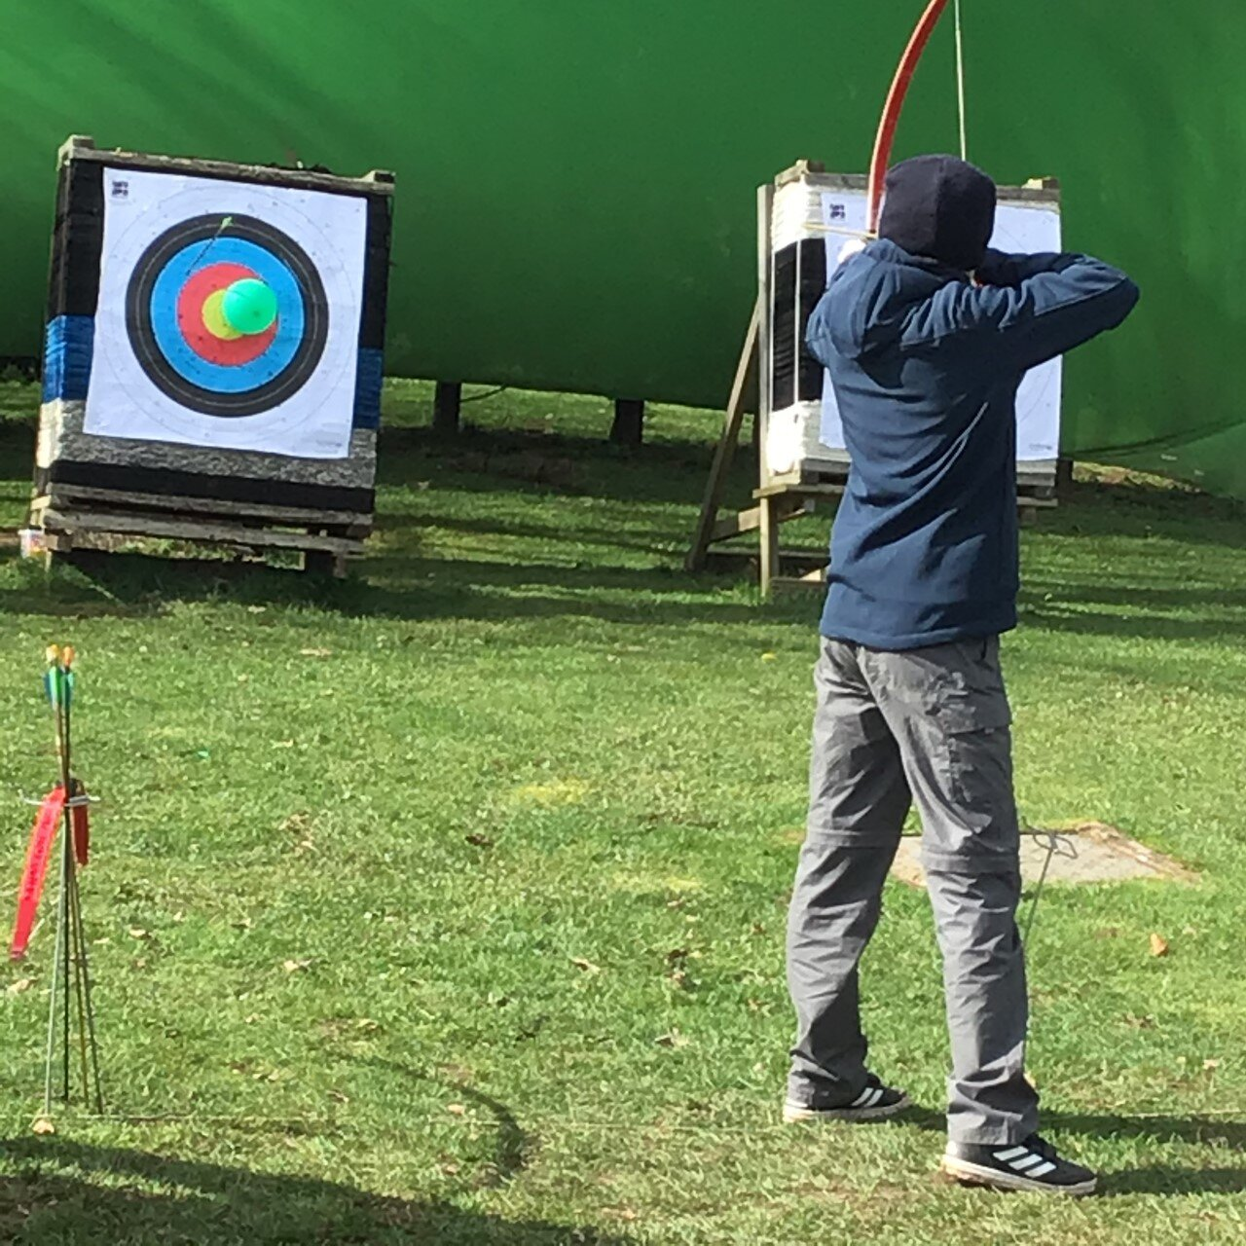
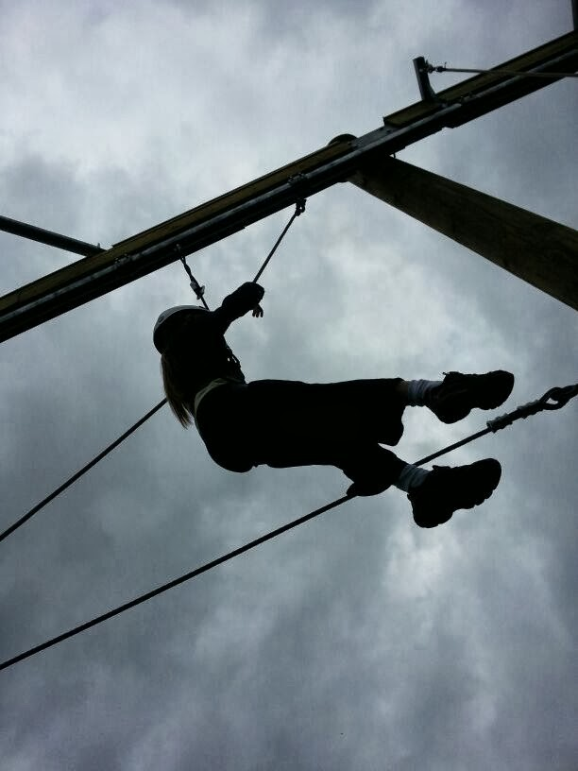
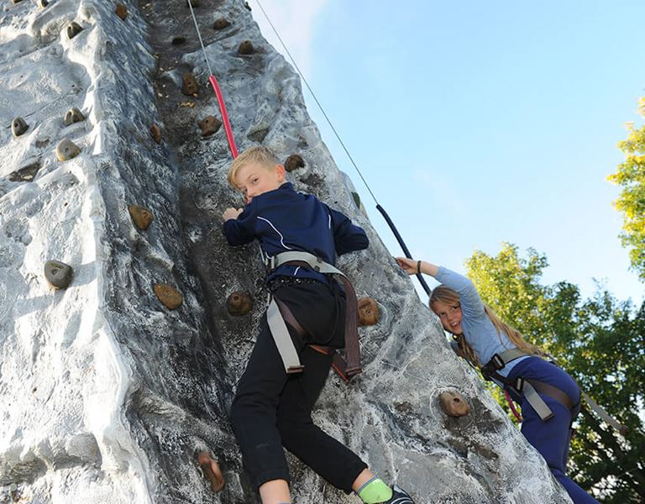
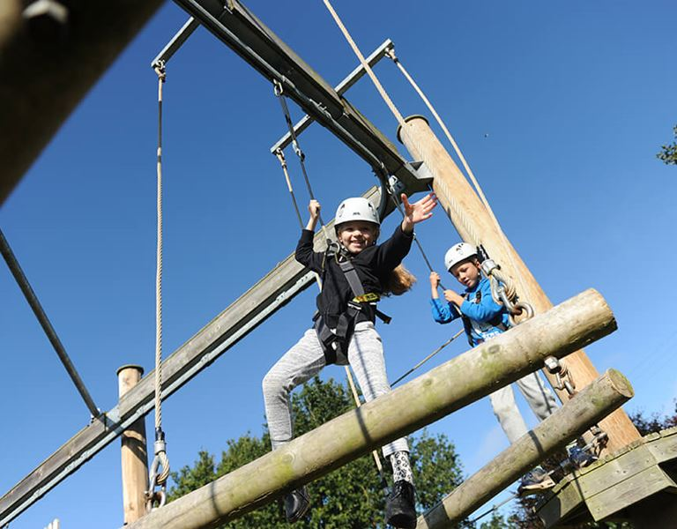
Astley Burf Residential June 2025

Slide 2
Key information and schedule
Monday 23rd June- Friday 27th June
Free time
-Rec room
-Adventure playground
-Zip wire
-football pitch
Monday: 9:30 Depart from School | Local walk/Shrawley Woods
Tuesday: Walk to Witley Court | 16:10 Coach to Astley
Wednesday: Activity day
Thursday: Aztec | Campfire
Friday: Pack/Orienteering | 13:00 Return to School

Slide 3
Expectations
Make beds
Set and clear dining table
Look after belongings including money (this will not be reimbursed if lost)
Look after any of the centre’s or school’s property and ensure it is returned after use.
Take care of facilities
Keep dorms tidy- prize for tidiest dorm

Slide 4
Health and Safety
Trained first aid staff
Staff on stand by 24 hours a day
Mr Hyde and Mr Pawelczyk will oversee any medication that needs to be taken
Full risk assessments have been carried out
Onsite caretaker- first aid trained
Whole area locked and fenced only authorised people are allowed in and out
Only OLSK on site- not sharing with anyone else

Slide 5
Who is going?
Mr Hyde
Mrs Pawelczyk
Mrs Finnegan
Mrs Harris
Mrs Turner
For the whole week

Slide 6
Accommodation
Children will be sleeping in log cabins with 6-8 children in each
Separate cabins for boys and girls
Evacuation procedures explained to children on arrival
Cabins are alarmed for any emergencies in the night (alert staff cabins)
Children will need to take responsibility for all their belongings and keep them together in their drawers
Showers and toilets in cabins
Cabins have a coded lock

Slide 7
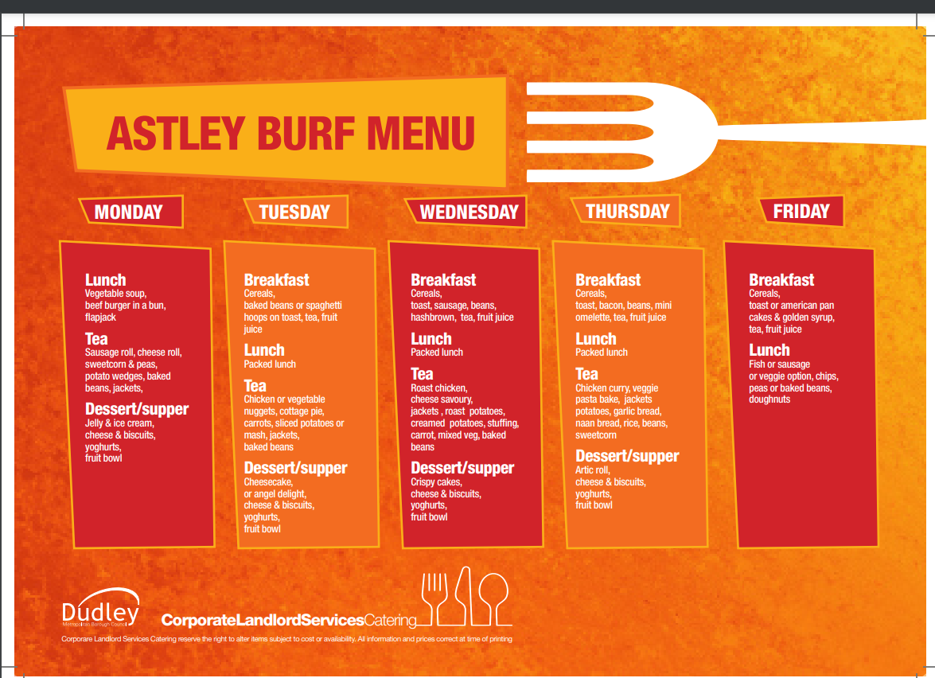

Slide 8
Kit
Sleeping bag
Pillow
Wash Kit
Towels
Sun protection cream
Water bottle- reusable
Bag for dirty washing
No mobile phones or electrical items
Reading book/ colouring
Pocket money- tuck shop and gift shop at Astley Burf. No more than £20- this is the child’s responsibility to look after.
Night attire including a dressing gown
Waterproof jacket
T shirts
Jumpers
Trousers and shorts
Socks and underwear
Hat
Trainers (spare pair for water activities/ rain)
Walking shoes

Slide 9
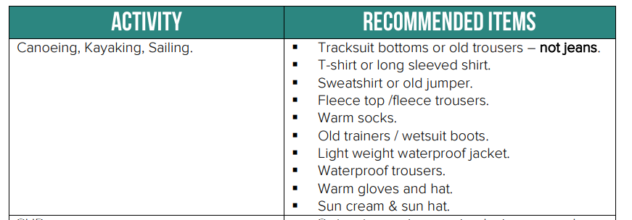
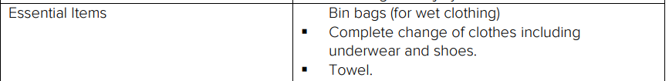

Slide 10
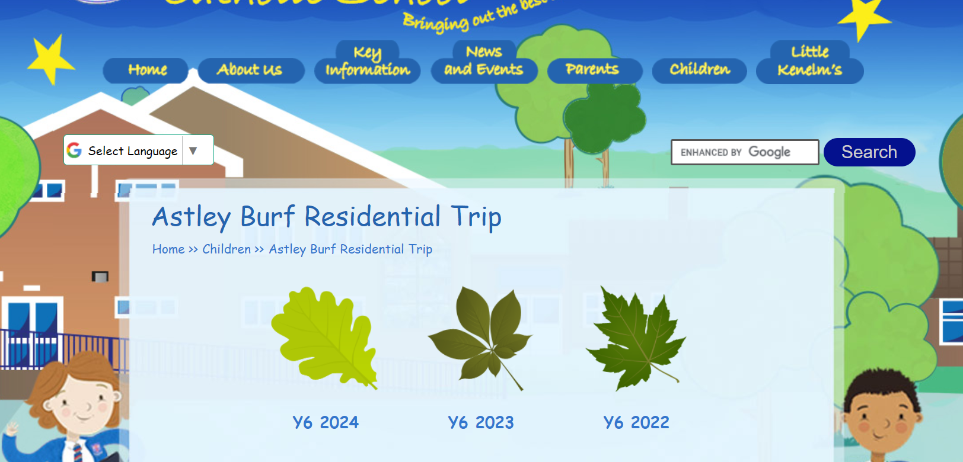

Slide 11
Coming home
On Friday, we will have breakfast and lunch. Once we are on the coach, we will send a text to let you know we have left & give you an ETA.
Once we are back at school, you can collect your child/ children
Please return the letter given out if you intend to collect your child early
On this occasion, parents must only collect their own children if collecting early.

Slide 12


