Slide 1
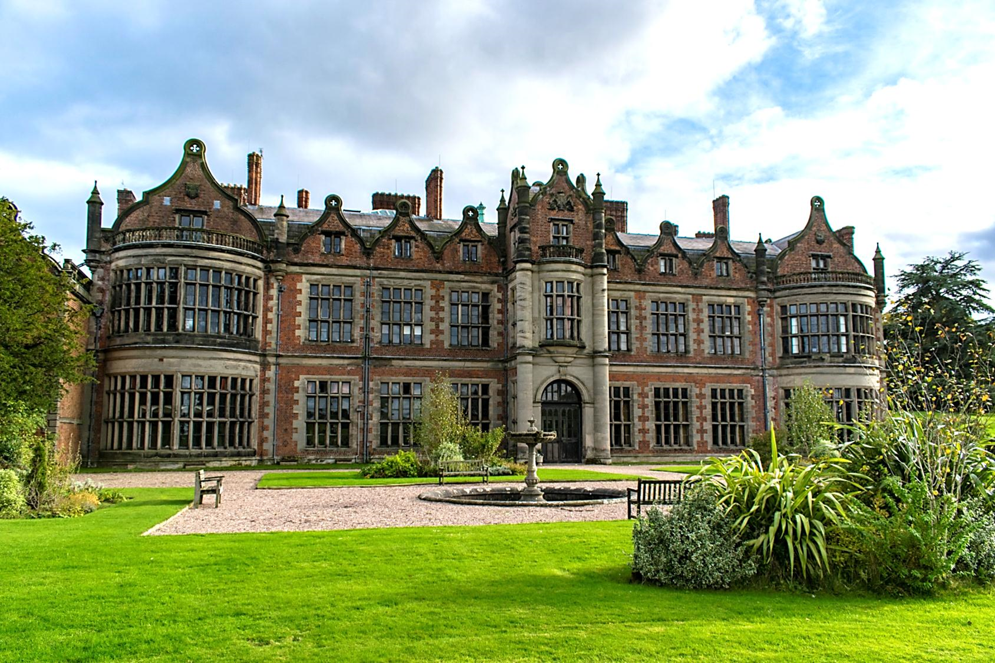

INGESTRE HALL RESIDENTIAL ARTS CENTRE
14th-16th October 2026

Slide 2

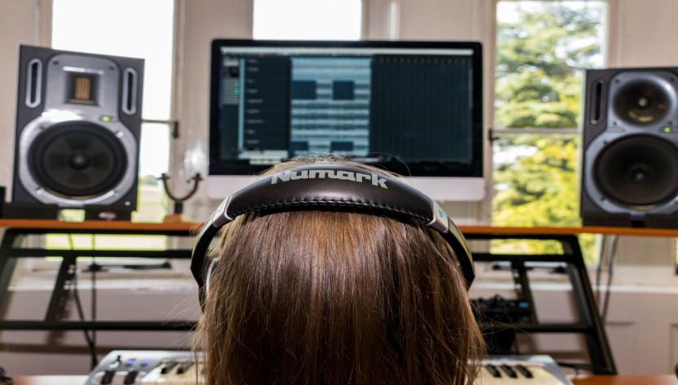

INGESTRE HALL: CENTRE FACTS
Location
A 400 year old Jacobean mansion creating a dramatic backdrop for creative & expressive arts.
Ingestre, Staffordshire, ST18 0RF
Outside
26 acres of landscaped gardens. Plenty of safe space to play.
Inside
Professionally equipped studios, including recording studio, live performance space and animation suites.
90 single beds
Dorms of 4 to 11
Groups of 50+ have sole occupancy

Slide 3
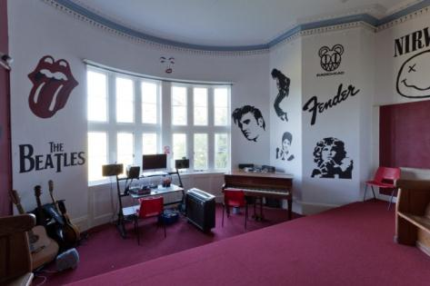
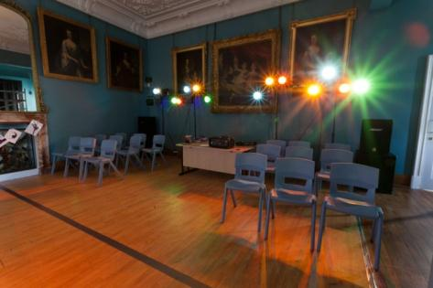
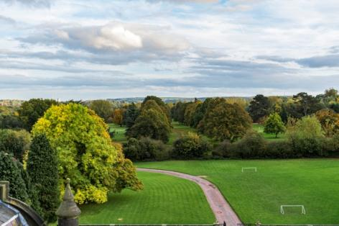
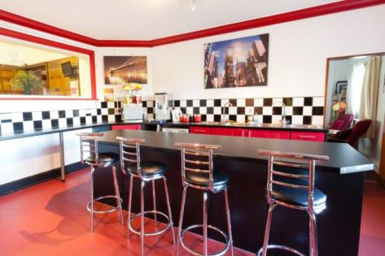
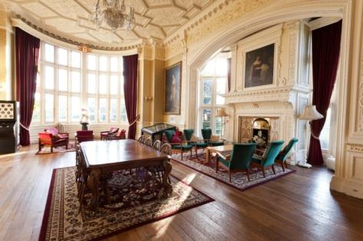
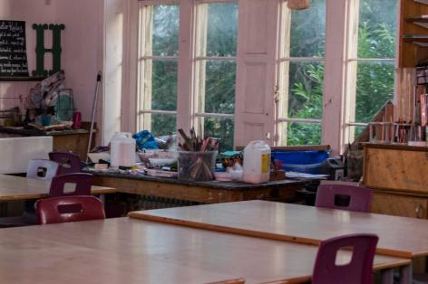




INGESTRE HALL
Notes:
We also have virtual tours which are available on the website

Slide 4
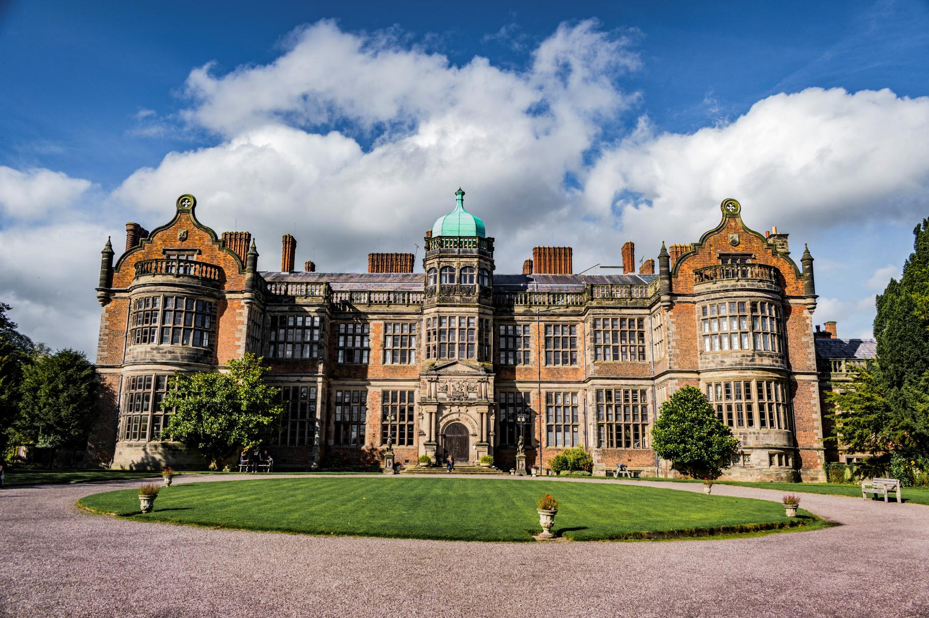
Notes:
Place: the more you immerse a young person – the more memorable it is, the more impactful the experience

Slide 5
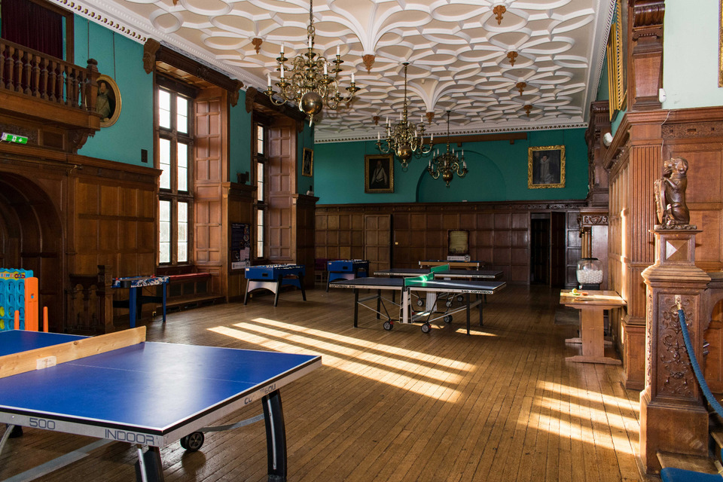

Slide 6
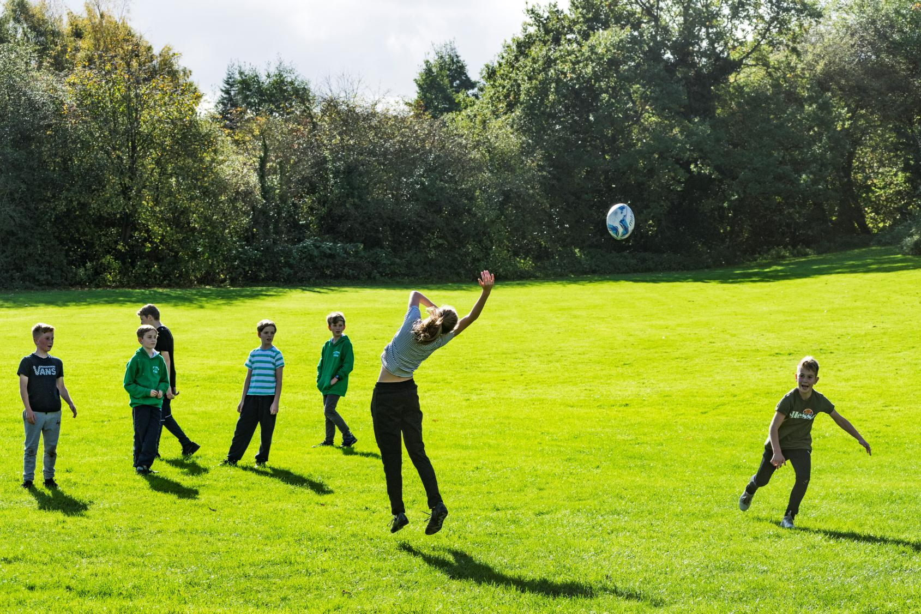
Notes:
Lots of space to play

Slide 7

ACTIVITIES
Activities at Ingestre are all about creating something original.
We give people the time and space to imagine, explore a topic, try things out, and share what they’ve done. It’s not just for the “arty” people!
Activities:
Drama
Art
Dance
Music
Creativity takes courage…..
…. but it’s a huge amount of fun!
Notes:
Place is important. So to are the activities – the things they do.
Creating something original based on a topic / stimulus:

Slide 8


Slide 9
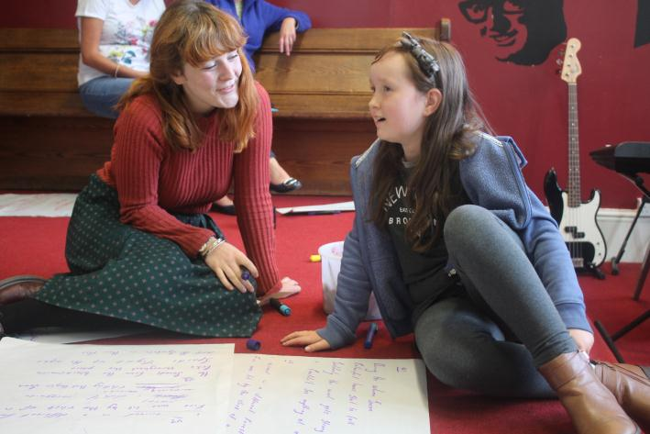
LEARNING
Whether it’s delivering high quality arts activities or simply learning through staying away from home and having fun, the Ingestre team have the soft skills to help every young person achieve more than they ever expected.
We are specialists in residential experiences, and know how valuable it can be.
Tailored Programmes
Every visit is unique. The team work with school and the pupils to shape an exciting, fun, and valuable visit to Ingestre.
Group sizes are 15 students to 1 Ingestre tutor supported by school staff.
Notes:
People – helping young people. Often quite anxious. Express themselves.

Slide 10
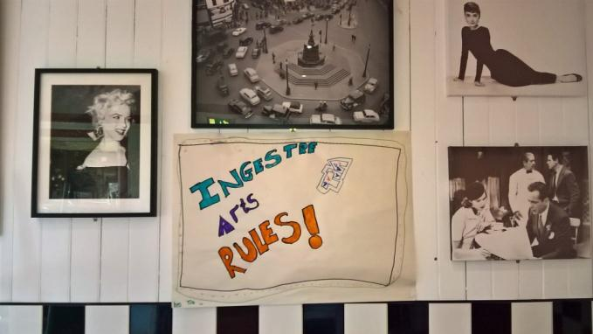
WHY GO TO INGESTRE HALL?
Try out exciting activities like animation, recording music, creating artwork such as pictures and sculptures, or creating a dance
Explore an amazing new place
Make new friends and get to know your classmates even better
Be adventurous: Go beyond your comfort zone and be open to new experiences.
Develop skills, discover passions, boost confidence
Notes:
Develop independence & critical thinking skills
Try new things and stick at them
Boost cohesion and sense of belonging
Professionally equipped studios
All inclusive – no hidden extras
School & centre staff work as one team to provide the best experience.
A warm welcome awaits – the centre soon becomes a home away from home.

Slide 11
THE EVIDENCE
“LEARNING AWAY” – BRILLIANT RESIDENTIALS
Learning Away conducted independent research over 5 years. Their findings show how a residential experience can:
Improve students’ engagement with learning
Support students’ achievement
Improve resilience, self-confidence & wellbeing
Smooth transition
www.learningaway.org.uk

Slide 12
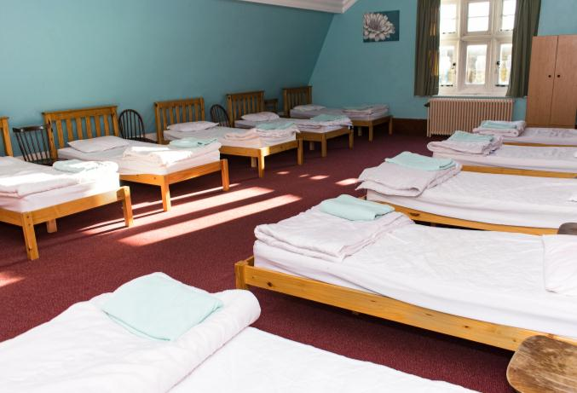
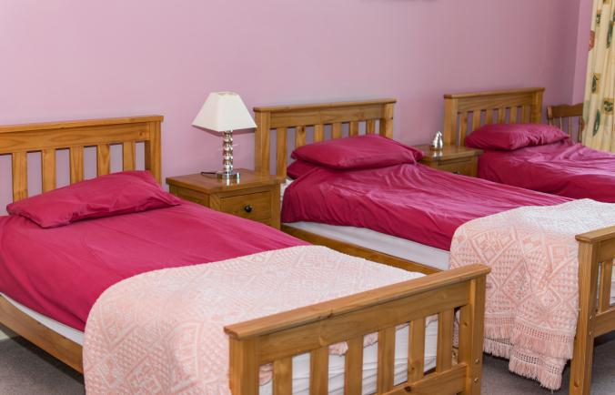
BEDROOMS
We have 90 single beds in comfortable dormitories.
Rooms sleep between 4 and 11 pupils
Groups of 50+ have sole use of the centre
All bedding is provided.
Pupils sleep in gender separated areas
Showers and toilet facilities are nearby
Teacher rooms are nearby and there is 24 hour on-site support from us.

Slide 13
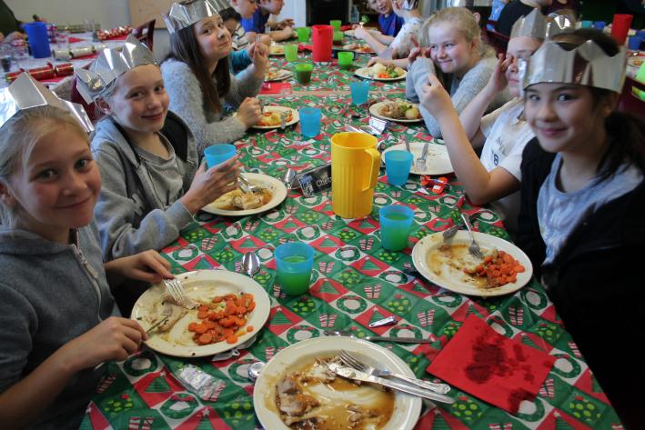
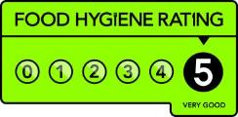
FOOD GLORIOUS FOOD
Home cooked food
We cater for all dietary requirements
Plenty of choice and variety
Example meals:
Pasta Bolognese & garlic bread
Fish fingers, chips & beans
Roast chicken, mash, stuffing & veg
Jacket potatoes with various toppings
Veggie curry, rice & naan

Slide 14

WHY GO TO INGESTRE HALL?
A PARENTS’ PERSPECTIVE
Develop independence & critical thinking skills
Try new things and stick at them
Boost cohesion and sense of belonging
Professionally equipped studios
All inclusive – no hidden extras
School & centre staff work as one team to provide the best experience.
A warm welcome awaits – the centre soon becomes a home away from home.

Slide 15
A TYPICAL DAY
-8:00 wake up!
-
-8:30 breakfast
-
-9:30 workshops
-
-12:30 lunch
-
-14:00 workshops
-
-17:15 dinner
-
18:30 evening activities
Sport & outdoor facilities and games
Nightwalks
Cinema
Disco
9:00pm- bed

Slide 16
Kit List
Important things to remember:
Children must bring a pair of shoes for indoor and outdoors. They will not be allowed to wear shoes both indoor and outdoor.
Children are welcome to wear slippers indoors but we recommend they have a back as the stairs are steep and floor is uneven so it is easy to slip.
Please only send children with what they need, they will have to walk their cases up and down Bundle Hill and carry them up 3-4 flights of stairs!
No electronic devices are allowed. Children may bring a disposable camera if they wish (not to use in dorms)
Different activities will require different kit- this should be on the list you received, this can be found on our school website at Children- Ingestre Hall Residential
There is a gift shop and a tuck shop, we recommend children bring no more than £10
No bedding is required- children will have to make their own beds so get practicing!

Slide 17
Medication
Any child requiring medicine including inhalers at Ingestre will need to return a medical form with all details of dosage so that staff can administer or supervise the child taking their medicine. This also includes eczema creams etc.
All medication must be in a labelled bag and given to Mr Hyde on the morning of the residential- it should not go in suitcases.
Children with inhalers must bring their inhaler from home- this will be kept in their school pouch all week.
Please do not send children with Calpol etc in their bags- all medication must be kept by staff

Slide 18
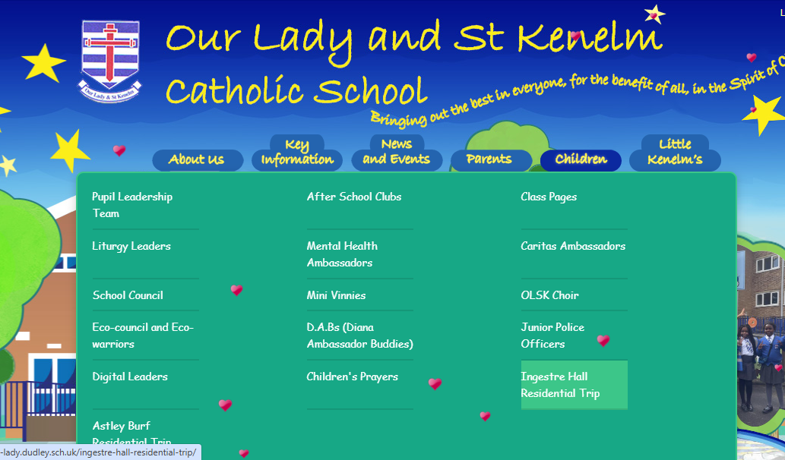
Contact
We will only contact you directly if there is an emergency or your child is unwell and needs collecting.
All updates and photos will be posted onto the school twitter page as well as the school website

Slide 19
Questions
Thank you for joining us! Your child will have a truly wonderful time at Ingestre and make memories that will last a lifetime.
If there are any questions then please don't hesitate to ask.

