Slide 1
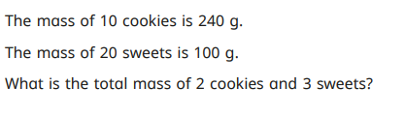
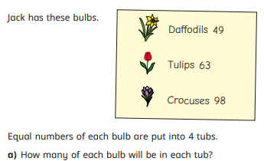
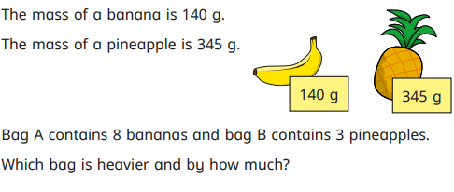
Good Morning- Maths Starter!

Slide 2
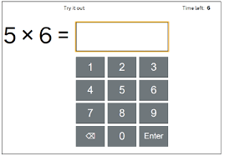
What is the MTC?
The Multiplication Tables Check (MTC) is a statutory Times Tables test for all children in Y4.
Children will be tested on 25 different multiplication questions and will have 6 seconds for each question.

Slide 3
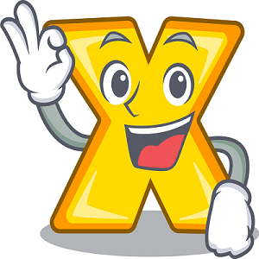
Why?
The Government introduced this test in 2022 as a way to target gaps in times tables knowledge.
Y5/6 maths relies on children confidently knowing and being able to recall their timestables otherwise valuable learning time has to be spent catching up.
Fluency is a key mathematical skill and one that will benefit children for the rest of their life.

Slide 4
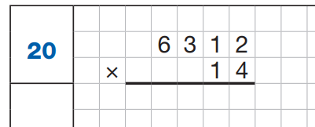
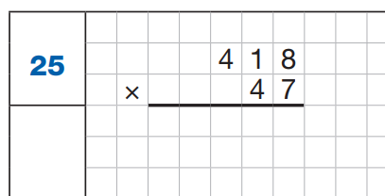
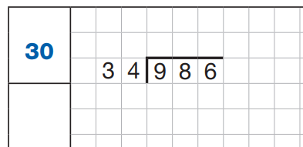
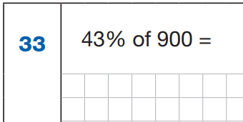
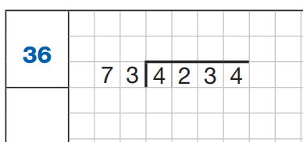
Why?

Slide 5
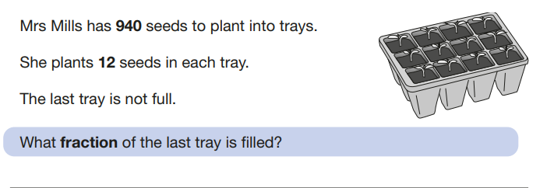
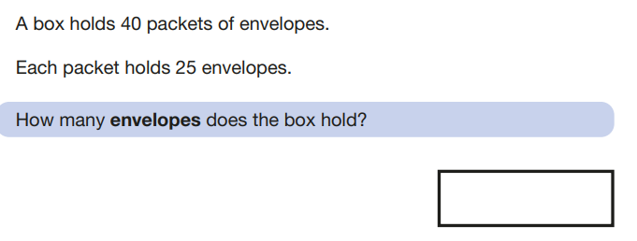
Why?

Slide 6
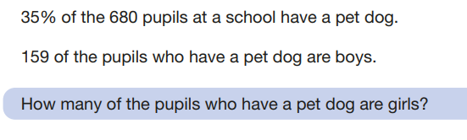
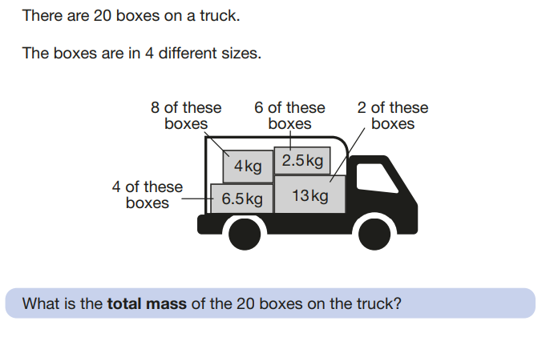
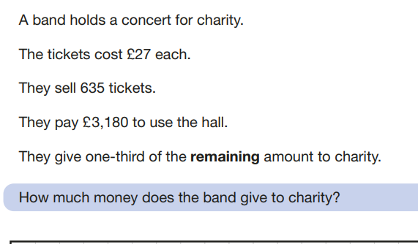
Why?

Slide 7
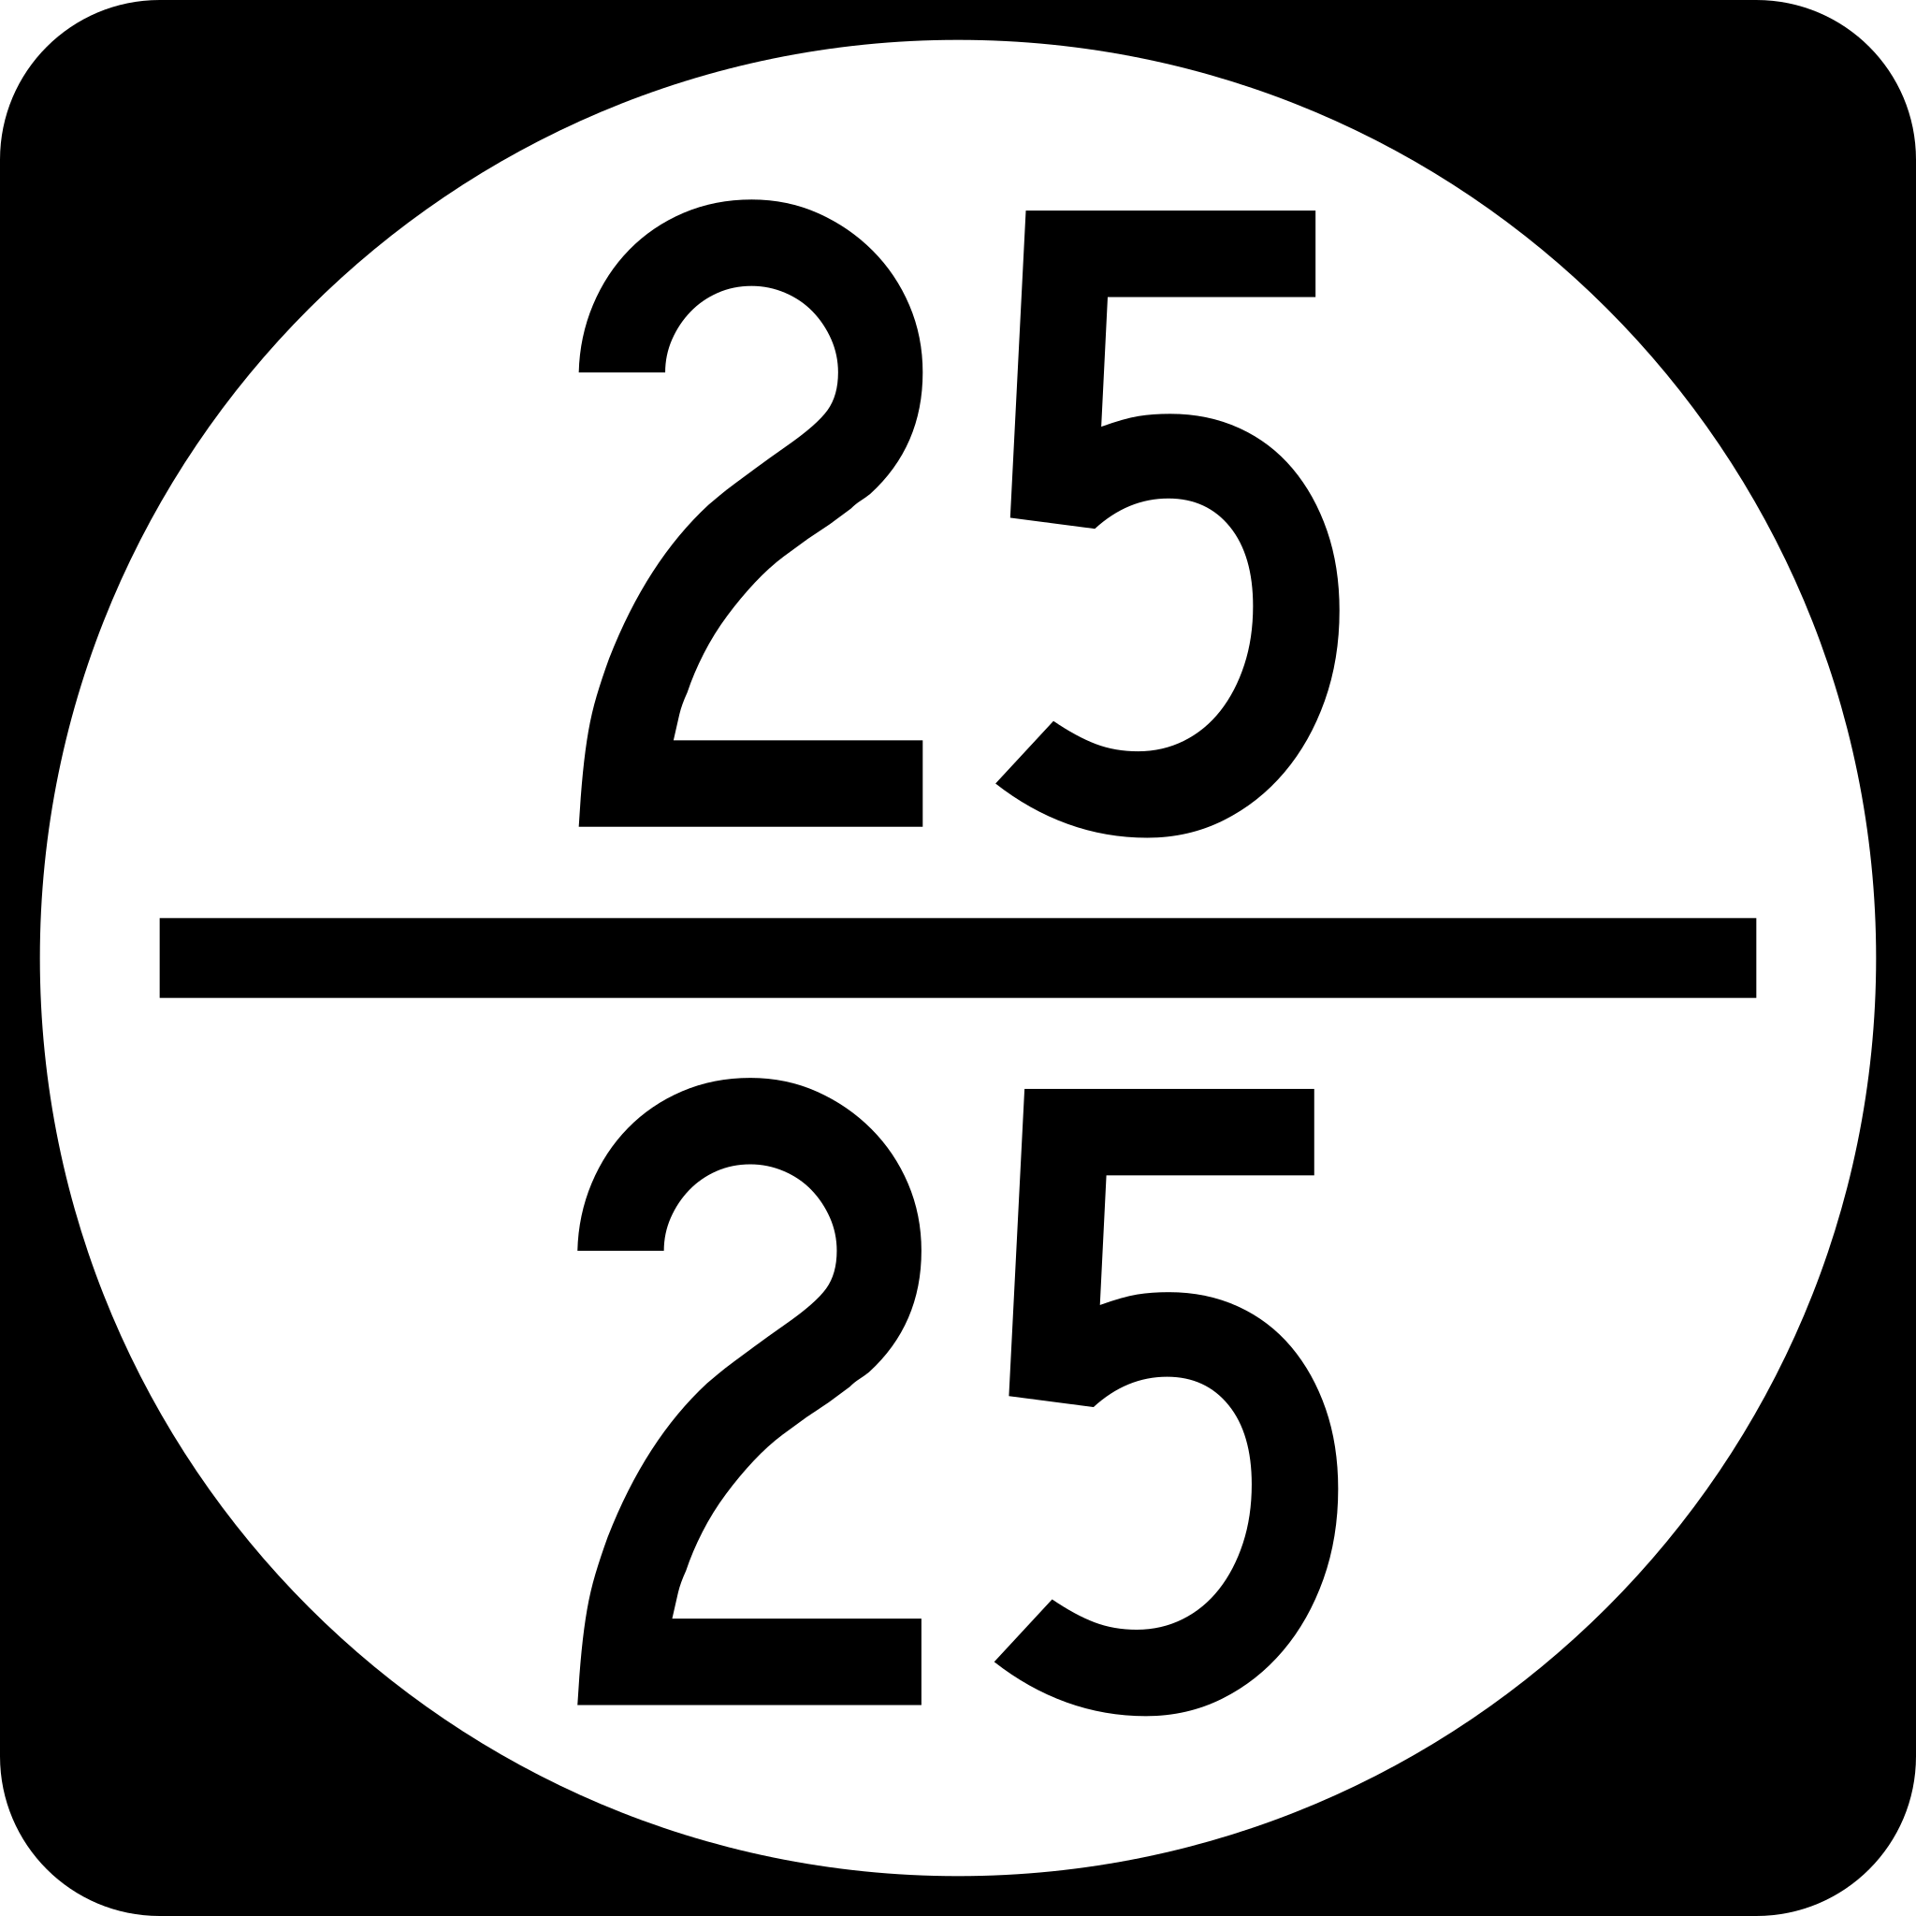
Scores
Children will get a score out of 25 based on how many they are able to answer.
If the timer runs out on a particular question, that will be counted as incorrect.
There is no official pass mark but we look for children to be scoring 20 or over.

Slide 8
When?
The assessment window opens on Monday 2nd June and runs until Friday 13th June.
Children will sit the test individually or in small groups with Mrs. Harris.
If children are absent then they can sit the test at any point during those two weeks.

Slide 9
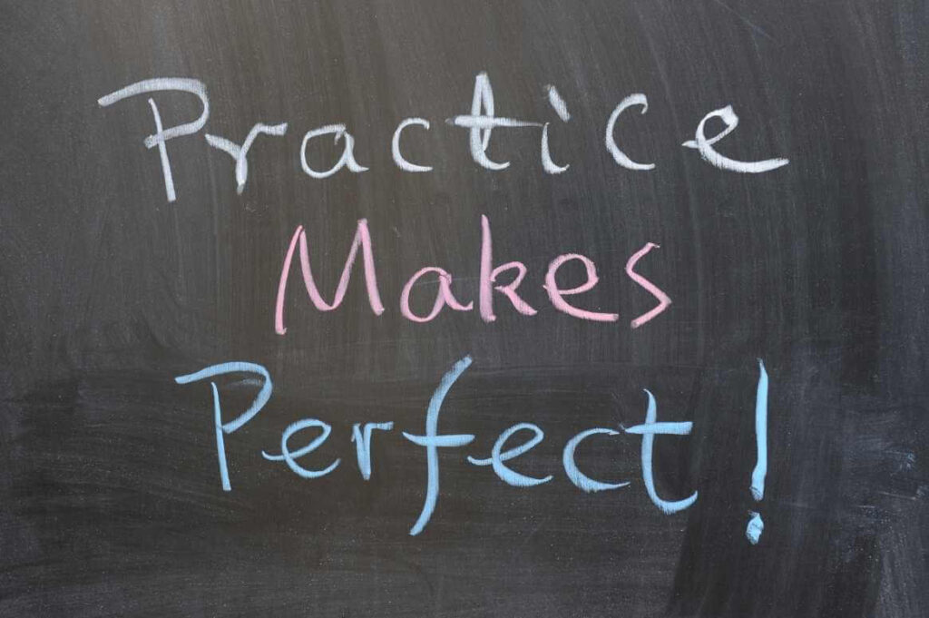
What you can do to help
Practice, practice, practice! The best way of learning times tables is to practice them as much as possible.
Allow children to practice using an iPad/phone as they need to be used to the layout of the numbers- we will do official practices in school but there are other sites that mimic the style of the test.

Slide 10

Useful Websites
Hit the button
timestables.co.uk
TopMarks
BBC Bitesize and Supermovers

