Slide 1

Welcome Parents
Mrs Lowe
Mrs Turner
Miss Carroll

Slide 2
What we expect in Y3
Children are expected to take more ownership of their learning.
To become independent learners.
To have a go and develop resilience.
Reflect on situations rather than reacting
Swimming & PE responsibility.
Collective Worship and leading Mass.
Classroom roles.
Complete homework- EBL, spellings, Maths & Reading.
Dedication to their Sacraments.

Slide 3

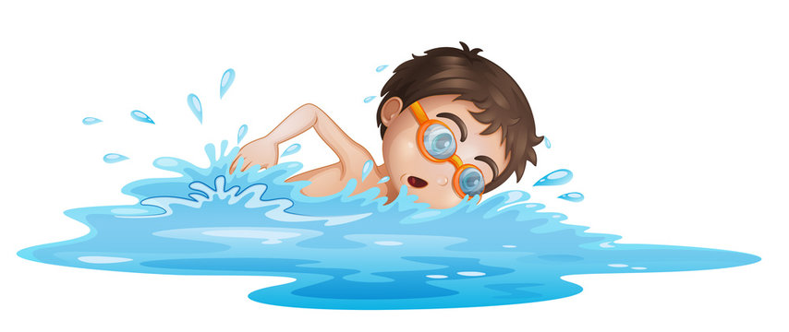
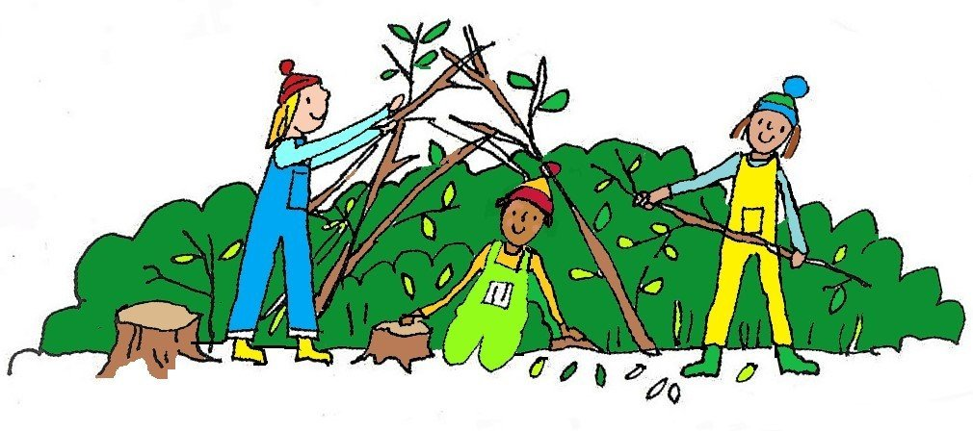
PE & Forest School
Swimming every Monday in the Autumn Term until February half term.
PE every Wednesday with our sports coach.
Forest school on rota on a Friday afternoon but dates will be given nearer the time

Slide 4
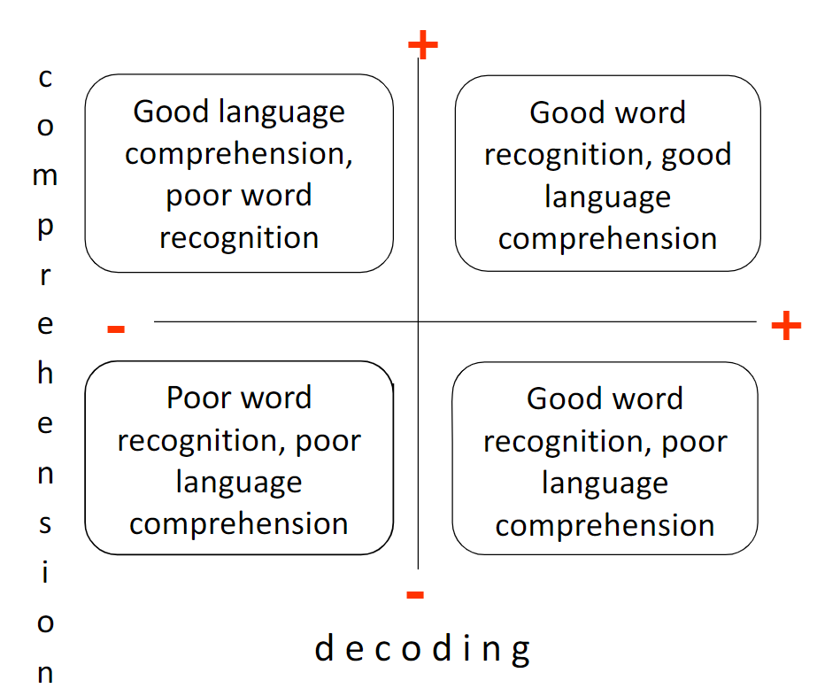
RWI & Reading
Reading assessments have been started to determine what book band your child is on.
If your child has finished their book, they need to ensure they show their reading diary to a teacher and then they can seek a new book from their book band.
Reading records and reading books must be sent in EVERY DAY!
It is important that a child reads with an adult every night.
Reading records to come into school every day.
Some children will receive RWI interventions in the morning. This is to give them a push in their early reading!

Slide 5

Handwriting
Handwriting is a huge expectation in KS2.
There are two key reasons handwriting remains important:
Automaticity in handwriting helps us write better content.
Handwriting helps us to learn what we write.
Children need to achieve automaticity in their letter production. Automaticity is being able to write and create letters without needing to think about the act of writing the letters themselves - instead, we're able to give cognitive attention to the content of what we're writing.
Handwriting is practised every day and modelled by teachers. If work is not to a high standard, children will be expected to redo their work.

Slide 6
Homework
Maths/Literacy
In Year 3, children will receive Maths/Literacy homework on a Friday. It needs to be in school to mark for the following Friday.
Reading
Try and listen to your child read – Again Important!
EBL
The Enquiry research question will be sent out every Wednesday and will need to be returned and ready to use for the following Wednesday. 1 A4 page.
Spellings
To be sent out every Friday for testing the following Friday.
If children forget their homework, they will be asked to do it within their lunchtime.
If children have lost their homework, they will need to ask for another copy.

Slide 7
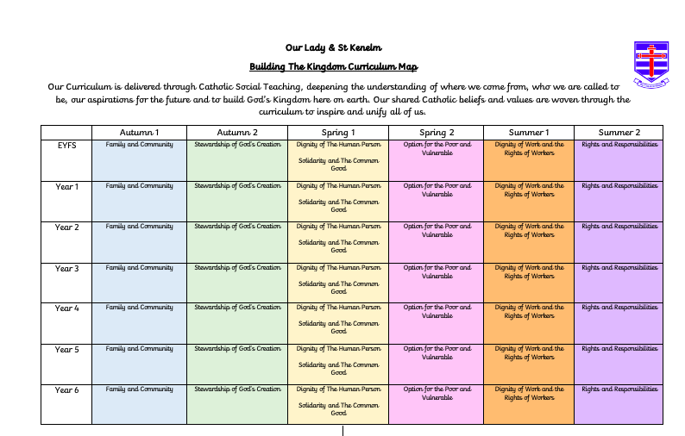

Slide 8
Enquiry Based Learning
Research question will be sent home every week.
Autumn 1 (Family & Community) – Does it matter where we come from? (Counties and Cities in the UK)
Autumn 2 (Stewardship of God’s creation)- Are we scarring or cultivating the earth? (No EBL question for this term- will be explored in other areas of the curriculum)
Spring 1 (Dignity and Solidarity)- Who are we called to be? (Stone Age to Iron Age)
Spring 2 (Option for the poor and vulnerable)- Does God’s creation cause harm? (Natural disasters)
Summer 1 (Dignity of workers)- Are we all God’s hands on earth? (Achievements of Early Civilisations)
Summer 2 (Rights and Responsibilities)– Is a culture of care possible? (Local History)
Notebook to record information – bring to school each week. 1 side of A4 only. This is to make bullet points, notes and include images to help their learning. You may wish to sit with your child to help them put their notes into structured sentences.
High quality learning of geographical and historical skills. Builds on prior knowledge and skills and equips them for the next year group and beyond.
Will help children become independent in their research and provide children will prior knowledge.

Slide 9
Autumn Learning Journey
Keep an eye out on our website for:
Regular updates on the Y3 class page.
Useful resources and websites.
Curriculum overview for Autumn.
News and updates for school.
Important Information
If your child is being collected by another adult, please let the school office know.
Earrings MUST be taken out for swimming and PE.
Water bottles, book bags and homework to be clearly labelled.
Be punctual.
Partnership with parents.

Slide 10
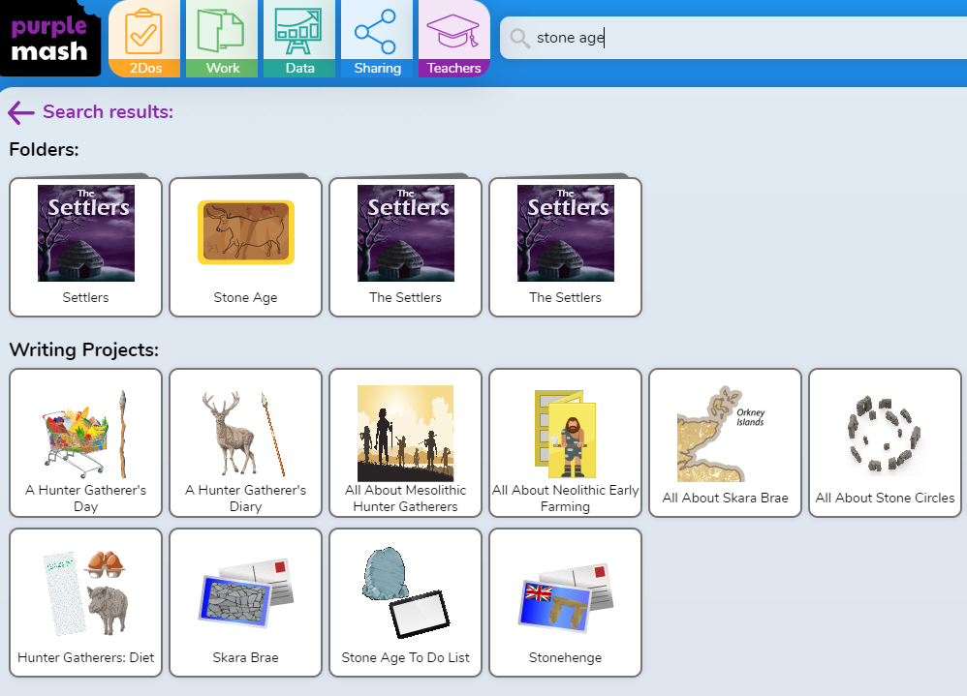
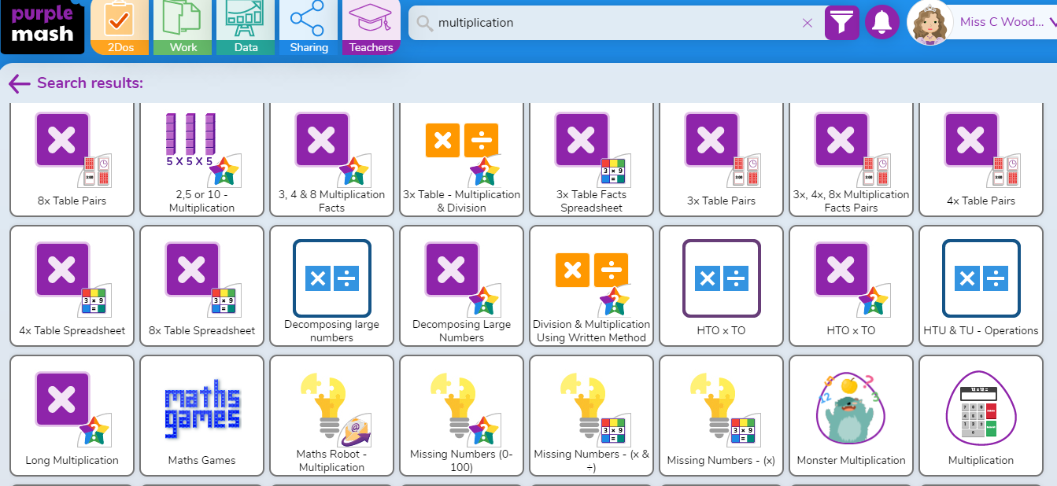
Things you can do at home!
Read with our children.
Homework.
Maths- arithmetic, times tables etc.
Purple Mash – Lots of activities and opportunities for learning.
MTC practice
EBL Research

Slide 11
Multiplication test Y4
Multiplication check in Y4.
Practise, practise, practise!

Slide 12
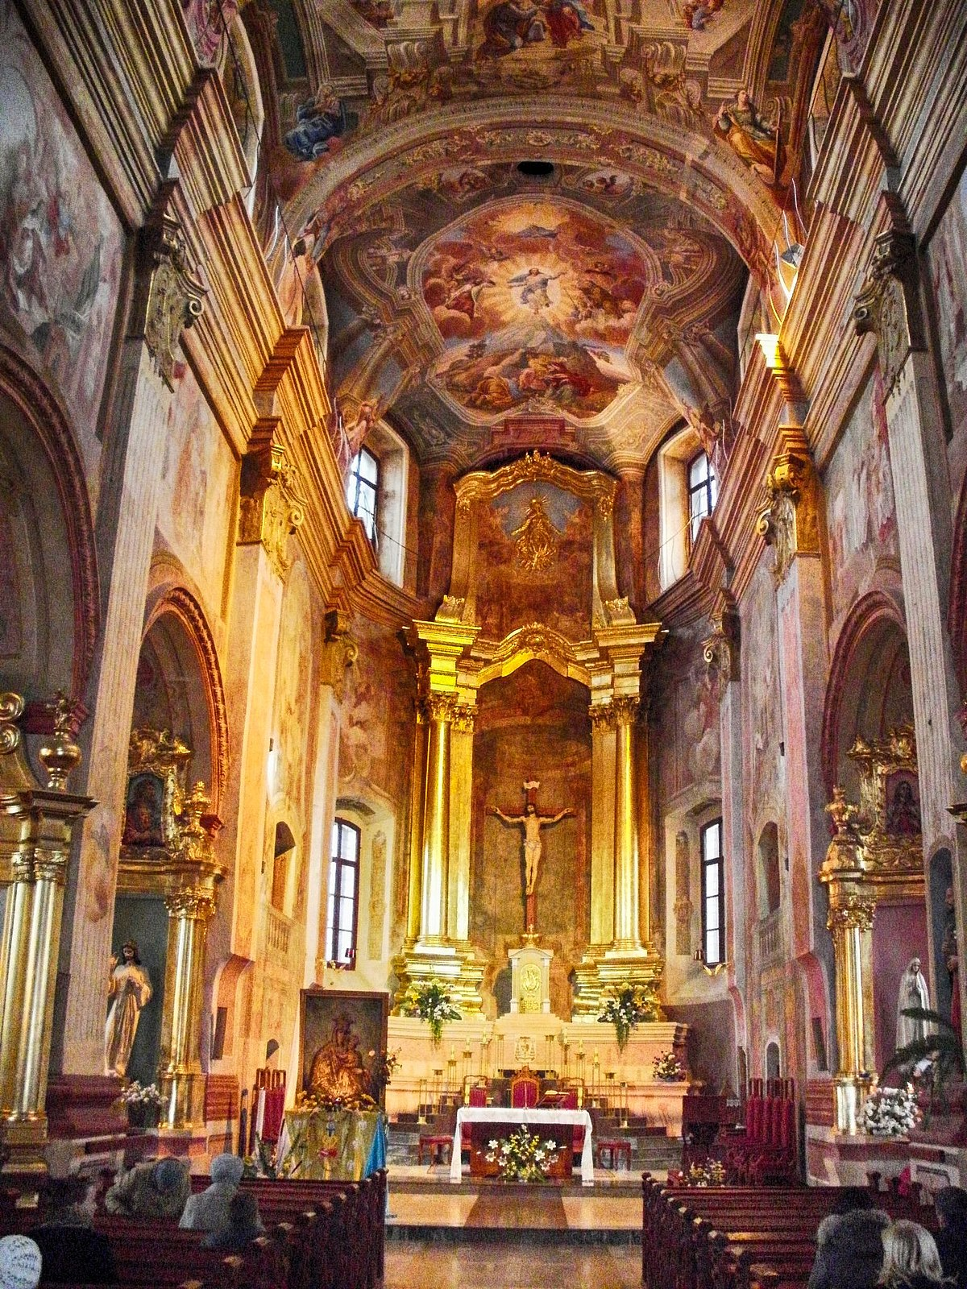
Sacrament of Reconciliation
Father Stefan will be in contact with parents prior to children making their sacrament. Parents only will be expected to attend meetings in Church.
Here children will learn the Act of Contrition. The ceremony takes places on a Saturday morning in the parish church during Lent. You will be given the date but if you cannot make it, please swap with another family and let Father Stefan know.
Sacrament of Holy Communion
This will be received by Y3 in June 2025.
Parents and carers will be invited to attend meetings throughout the year to be given important information and how to help you child on their spiritual journey.
After the First Holy Communion Mass, usually the following Thursday, children are invited to wear their communion clothes to celebrate their Mass of Thanksgiving with parents in attendance. Here they will be presented with their certificates and enjoy their Holy Communion breakfast.
More information can be found on the website.

Slide 13

Any questions?
Thank you for listening and we look forward to working with yourself and your child in Year 3!
☺

