Slide 1




Introduction to the Reflexions team
To understand what we do and how we can help.
To understand what CBT is.
What targeted support we can offer to CYP and to parents.
Notes:
Introductions- who we are and aims of today.

Slide 2


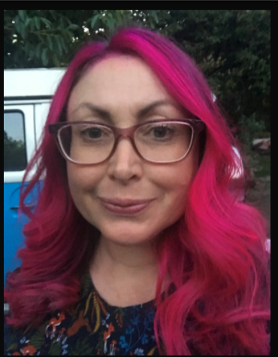


I am Tori your
Children’s Wellbeing Practitioner
Notes:
Hello I am your child wellbeing practitioner Tori

Slide 3

Notes:
Icebreaker- name- NAME AND year of child and favourite biscuit.

Slide 4
IS
Group reminders
These sessions are here to help you and are here for information and advice only.
This is a non judgmental space.
Confidentiality
We encourage you to get involved however please be mindful what you share with the group. If you would like to chat to us 1.1 we will happy to ask any questions and will be available at the end.

Slide 5

What is Mental Health?
Notes:
Discussion – what do they think this is?

Slide 6

Mental Health is about our feelings, our thinking, our emotions and our mood.
Things you cannot really see but it can affect our lives in lots of ways.
Notes:
It’s different to our physical health as we can’t always see it in the same way that we can see a broken arm or chicken pox.
Can anyone think of how poor MH can affect our lives?
Everyone has mh.

Slide 7

Mental Health Support teams.
Mental health support teams work closely with CAMHS but we are our own separate team called Reflexions.
We are based within schools and colleges and only schools and colleges can refer to us.
We are an early intervention service which works with mild/moderate mental health difficulties.
We work across the Black Country.
Notes:
.

Slide 8

History and Background.
In 2011, the government pledged £79m to support children and their mental health within the community.
EMHPs are a part of the Mental Health Support team who have been commissioned by the government from the green paper to deliver low intensity support CBT to children/ young people.
Aim of this huge initiative is to reach CYP early, reduce waiting times and improve access.
Notes:
Better Access to Mental Health services

Slide 9
How do you feel as parents having a mental health service in school?

Slide 10

What we do
We deliver both 1:1 and group CBT interventions to children and young people.
We offer awareness workshops to staff, parents and children.
We work with other services such as education psychology and school nursing.
We are a year-round service (not just term time).
Notes:
.

Slide 11
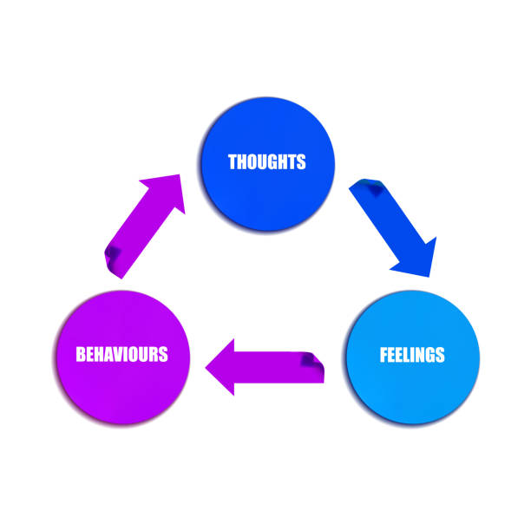
Notes:
.

Slide 12
What we can work with…
Low mood
Panic
Sleep Hygiene
Anxiety
Generalised anxiety & separation anxiety
Worry Management
Mild behavioural difficulties
Notes:
.

Slide 13

Workshops we offer to parents…
Supporting your child with anxiety around exams and transitions
Supporting your child to get a good night’s sleep
Supporting your child with anxiety
Supporting your child with low mood
Talking to your child about mental health
Strengthening connections
Notes:
.

Slide 14
How does it work?
School/parent identify CYP.
Discussion with parent.
School submits referral.
Referral screened and identified if suitable.
If suitable parent contacted and assessment arranged
Assessment will take place in school with CYP to determine suitability.
Intervention sessions
(between 6-8 will then take place).
Notes:
.

Slide 15

Thinking about what we do,
What could we do to help you or your child?
Is there anything you would like to know more about?

Slide 16

5 ways to wellbeing

Slide 17





Notes:
Childline- 24/7 support for children up to age of 19 years old
Mind- information on mental health
Kooth- information for young people aged 11 and over.
Happier minds website- new local mental health website with lots of resources and information.

Slide 18

Notes:
Feedback.

Slide 19

Thank you for listening
Any questions?

