Slide 1

Online Safety

Slide 2
Why?
Keeping Children Safe in Education has 155 mentions of the word ‘online.’
Definition of safeguarding includes ‘protecting children from maltreatment, whether that is within or outside the home, including online’
All forms of abuse can take place online including child on child

Slide 3
Online Safety
Online safety is a broad topic but can be covered in 4 areas:
Content- being exposed to illegal or harmful content
Contact- being subjected to harmful online interaction with others
Conduct- online behaviour that increases likelihood of harm
Commerce- online gambling, inappropriate advertising, phishing and scams

Slide 4
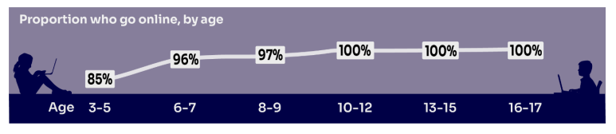
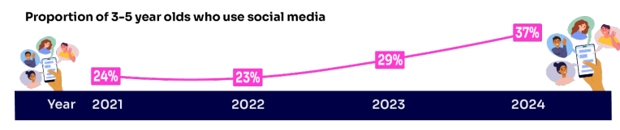
Background

Slide 5
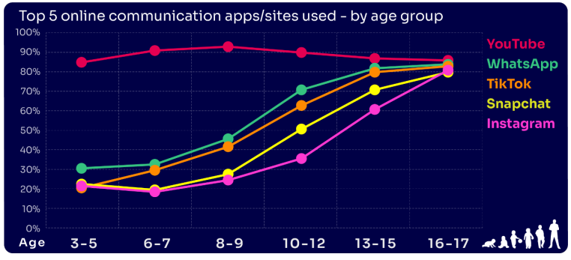

Slide 6




Age Limits
13
13
13
16

Slide 7
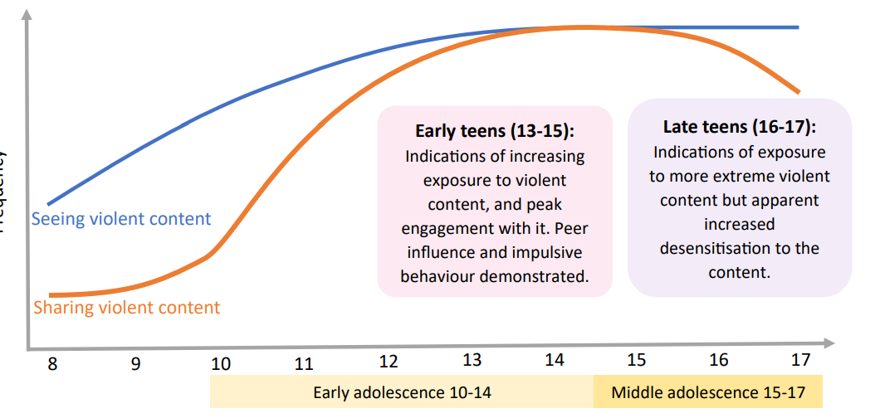
Content- Violence
Impacts of viewing violent content
Guilt
Anxiety
Lack of sleep
Becoming desensitised
Adopting violent behaviour
Source- Ofcom

Slide 8
Content- Porn
“More respondents said they had seen pornography online by accident (59%) than said they had deliberately sought it out (35%).”
“More than a quarter (27%) now said they had seen porn online by 11, with some saying they were “aged six or younger” when asked about their first exposure.”
“Networking and social media sites accounted for 80% of the main sources by which children accessed porn. X was the most common source of pornography for children, outstripping dedicated porn sites.”
Source- The Guardian

Slide 9
Contact
“An estimated 19.2% of children spoke to or exchanged messages with someone online in the last year who they had never met in person before and 4.4% met up in person with someone they had only spoken to online, with boys more likely than girls (5.7% compared with 3.1%).”
“Just over a third (35.0%) of children accepted a friend request online from someone they did not know and 8.5% had shared their location publicly, in the last year.”
“Over 9,000 child sexual abuse offences involved an online element in 2022/23”
More than 7,000 Sexual Communication with a Child offences were recorded by police in 2023/24- 48% of these were on Snapchat
Source- ONS + NSPCC

Slide 10
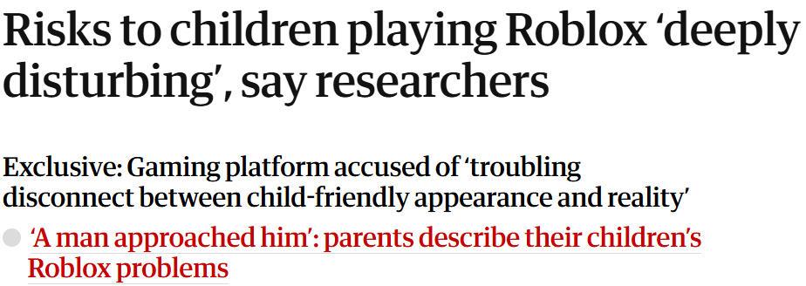
Contact- Roblox
In 2024, the platform had more than 85 million daily active users, an estimated 40% of whom are under 13
Latest research (September 2025) says that Roblox has made improvements to its safety measures, however there are still significant issues

Slide 11
Contact- Roblox
“it’s still remarkably easy to create an account with a false age. Adults can continue to create accounts pretending to be children.”
“While Roblox is taking steps to prevent under 17s from entering adult spaces, adults are still able to enter children’s spaces, and can play, chat and speak with phone verified users registered as 13+”
“There is nothing stopping under 13s, or adults from creating an account as a 13+ child and speak with other users, adults or children, as long as they add a phone number on their account.”

Slide 12
Contact- Roblox
  It still possible to circumvent chat restrictions. Our adult avatar was able to ask for, and receive, our child avatar's Snapchat details by using the word "pans" (snap backwards) or using different fonts.
  Filters and moderation on in-game voice chat do not seem to be fully effective, as our adult and child avatars were easily able to exchange contact details.
  Our child avatar was still able to experience inappropriate behaviour on the chat, and over audio. This included racial slurs, sexual acts, swear words.

Slide 13
Conduct- What factors increase risk of harm online?
Unengaged/partially engaged parents- unaware of exactly what their children are listening to or watching
Offline activities- Children who are more active offline are at less risk of abuse online. They are also better at managing mental health and are less likely to be impacted by issues around body image etc.
Age- Younger children are more likely to not understand the potential risks of being online, leading to an increased risk of harm
SEND- more vulnerable to manipulation
Being socially isolated
Peer pressure and the fear of ‘missing out.’

Slide 14
What can you do?
Be involved
Privacy settings
Teach children to block and report
Chat settings
Be a good digital role model
Open, non-judgmental conversations

Slide 15
What do we do?
Monitoring and filtering system
RSHE and computing curriculum
Listen
Report- if parents are not keeping children safe online, we have a duty of care to report

Slide 16
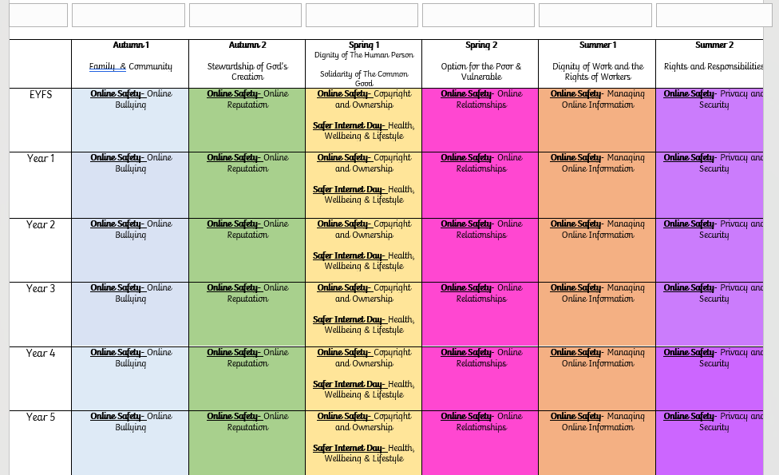

Slide 17
Resources
NSPCC
CEOP- reporting of abuse
Childline
School Website
National College- Wake Up Wednesday

